Slide 1

salary Share
CS 157A – Database Management Systems
San Jose State University
5.30.22

Slide 2

Agenda
INTRODUCTION
MOTIVATION
DESIGN PROCESS
TESTING
DEPLOYMENT
DEMO

Slide 3


Meet the team
Saad
Junior
ARUN
Senior
Raul
Senior
Coder Extraordinaire

Slide 4

MOTIVATION

Slide 5

The PROBLEM
Wage Disparity
Lack of transparency for each position
Lack of baseline salary to negotiate off
Notes:
Some engineers get paid different amounts for the same job
- potential for some companies undercutting employee value – paying them less than their worth
Students and unemployed alike apply to find jobs but do not know what their starting salary should be. We aim to help them by providing a range that they can request based on their requirements.

Slide 6

The Solution
Create a platform for voluntary salary reporting
Allows job seeker to have a baseline for negotiations
Knowledge of industry/market average provides job seeker leverage
Notes:
Job seekers knowing their market value allows them to get their worth

Slide 7
DESIGN PROCESS

Slide 8
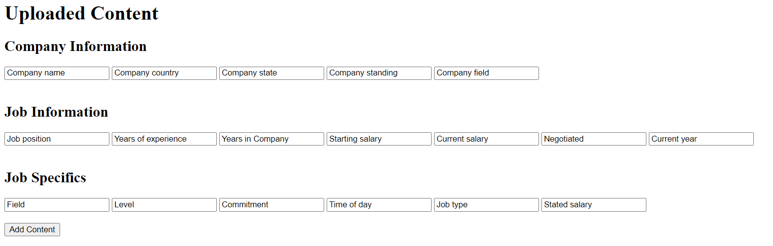
Conceptual Design reporting wage information

Slide 9
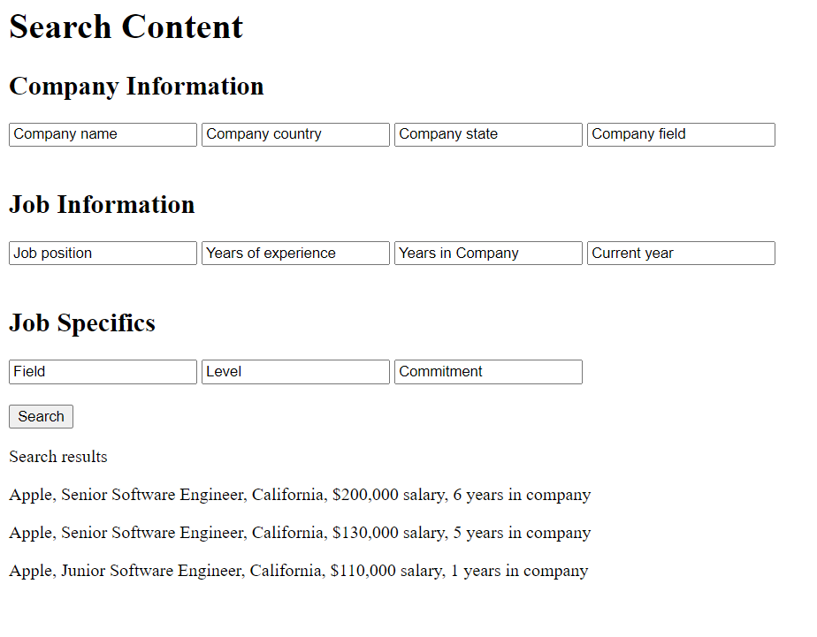
Conceptual Design Querying Wage Information
Notes:
Baseline information that can be queried
Sample output

Slide 10
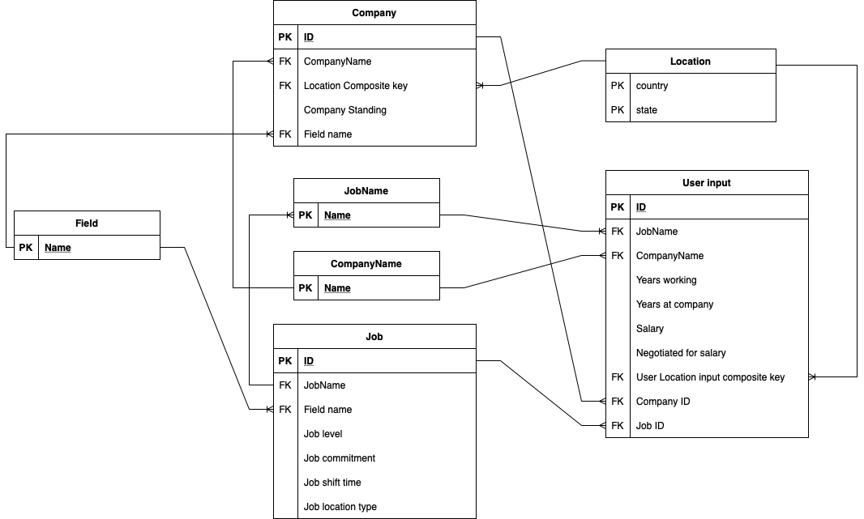
Logical Design
Notes:
User input links to company and a certain job
When user inputs on front end, input is parsed
We check if job & company entries already in their tables
If they are, get their PK and reference it
Else create entries
Logical design is in 3NF
BUSINESS RULES:
Can have two jobs with the same name because they can have different job level/commitment/shift time etc.
Two companies may have the same name – however companies with same name must have different location
Company location references head quarter's location
User input can have a different location than the company that it relates to

Slide 11
Physical design
Designed in MySQL
Implemented logical design
Client/Server Scheme

Slide 12
TESTING

Slide 13
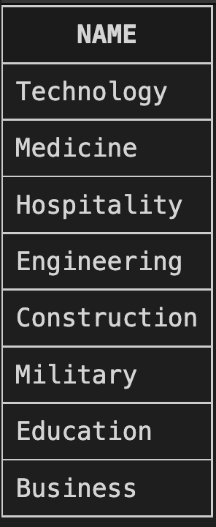
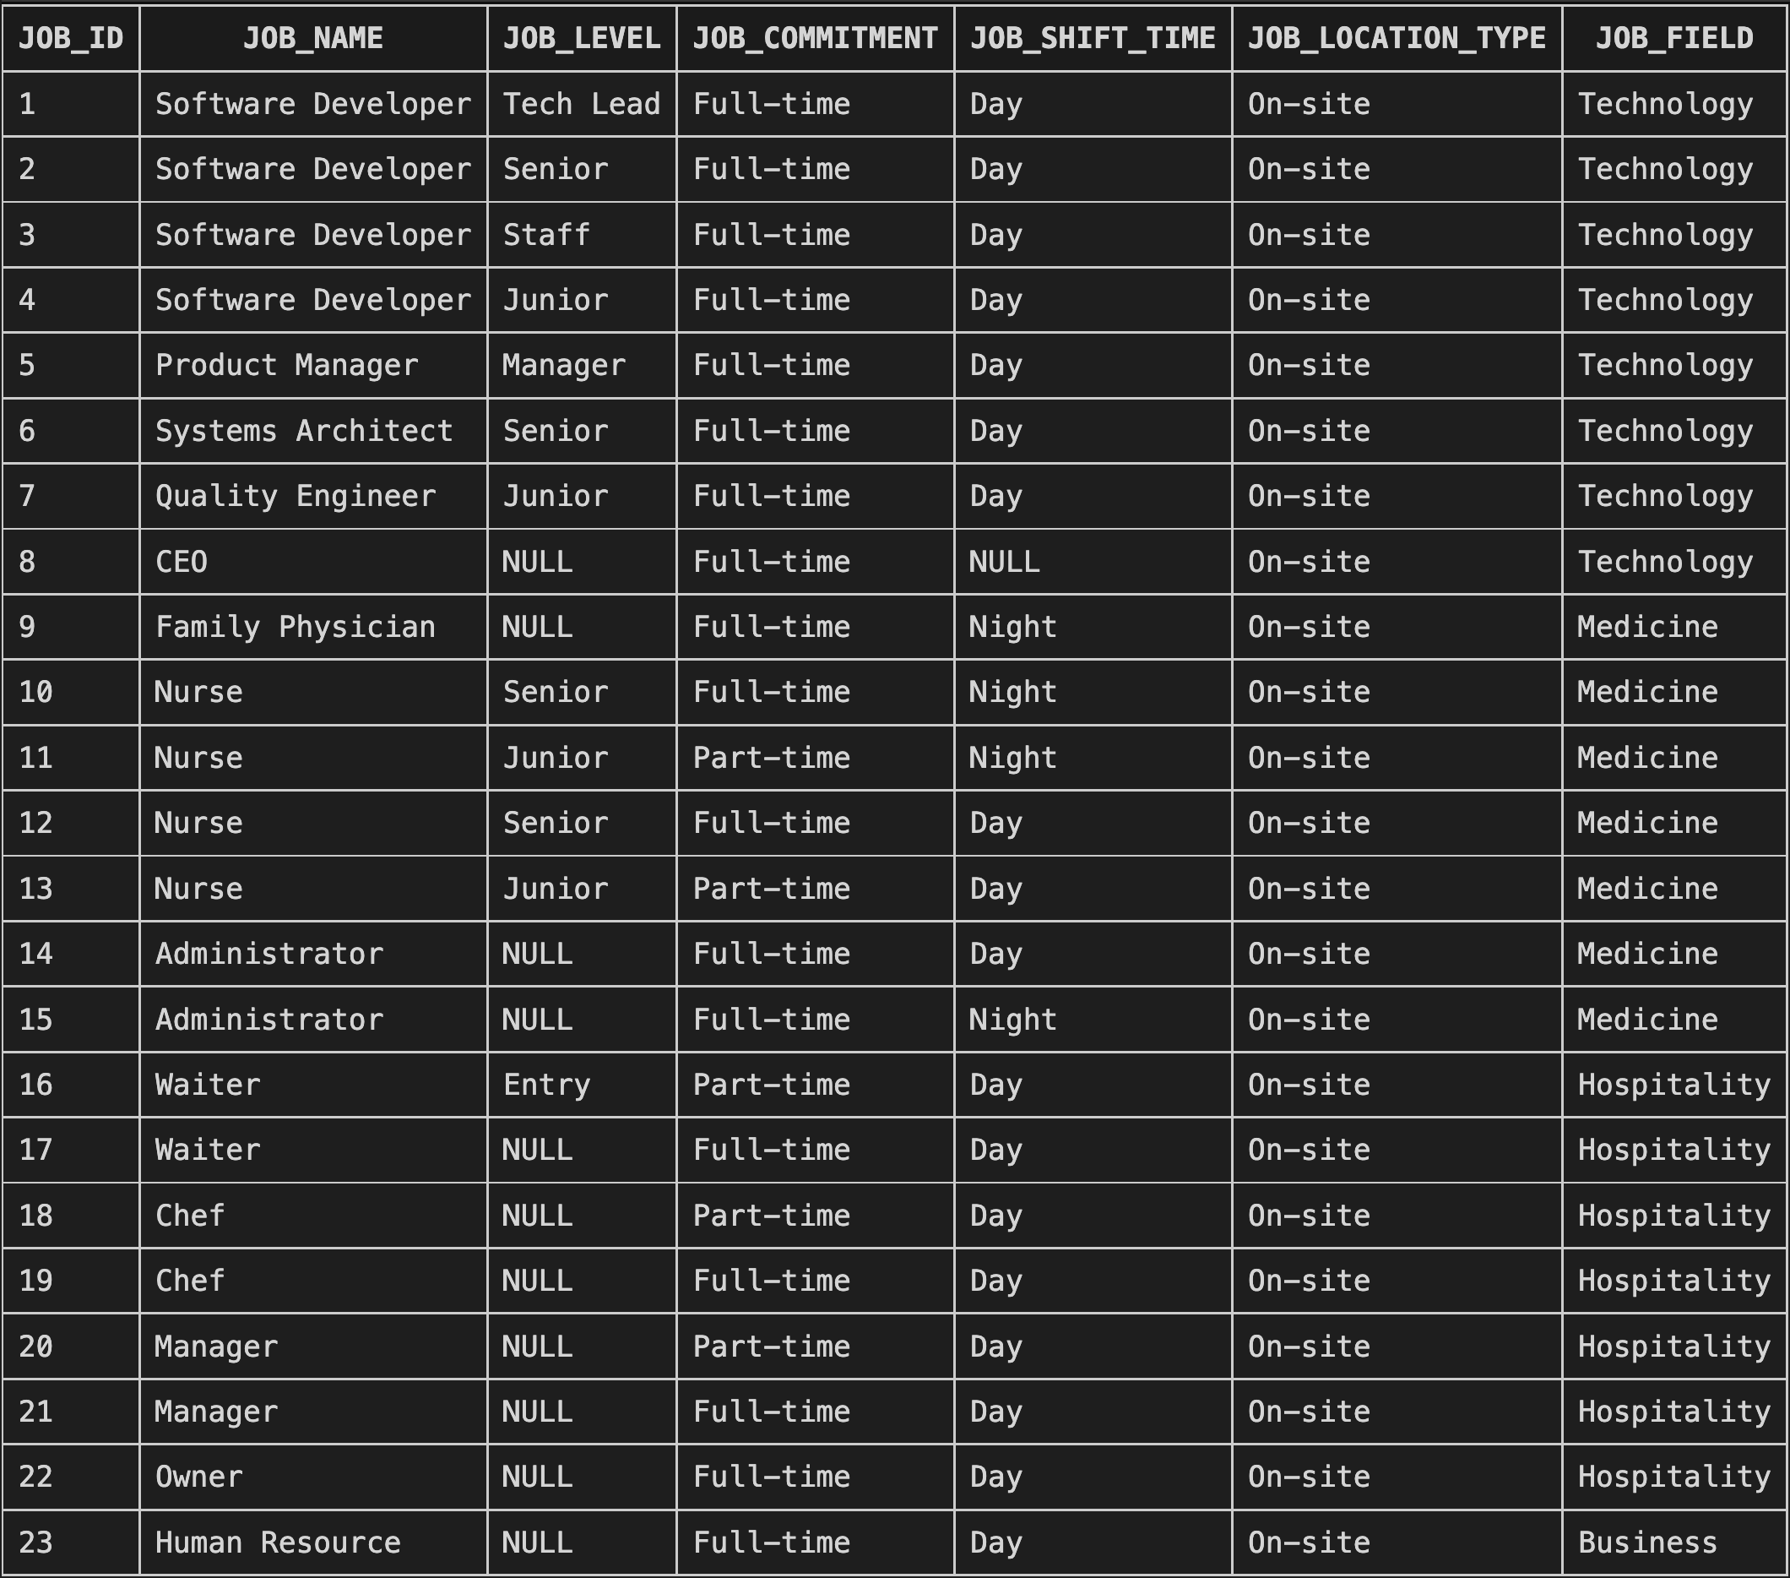
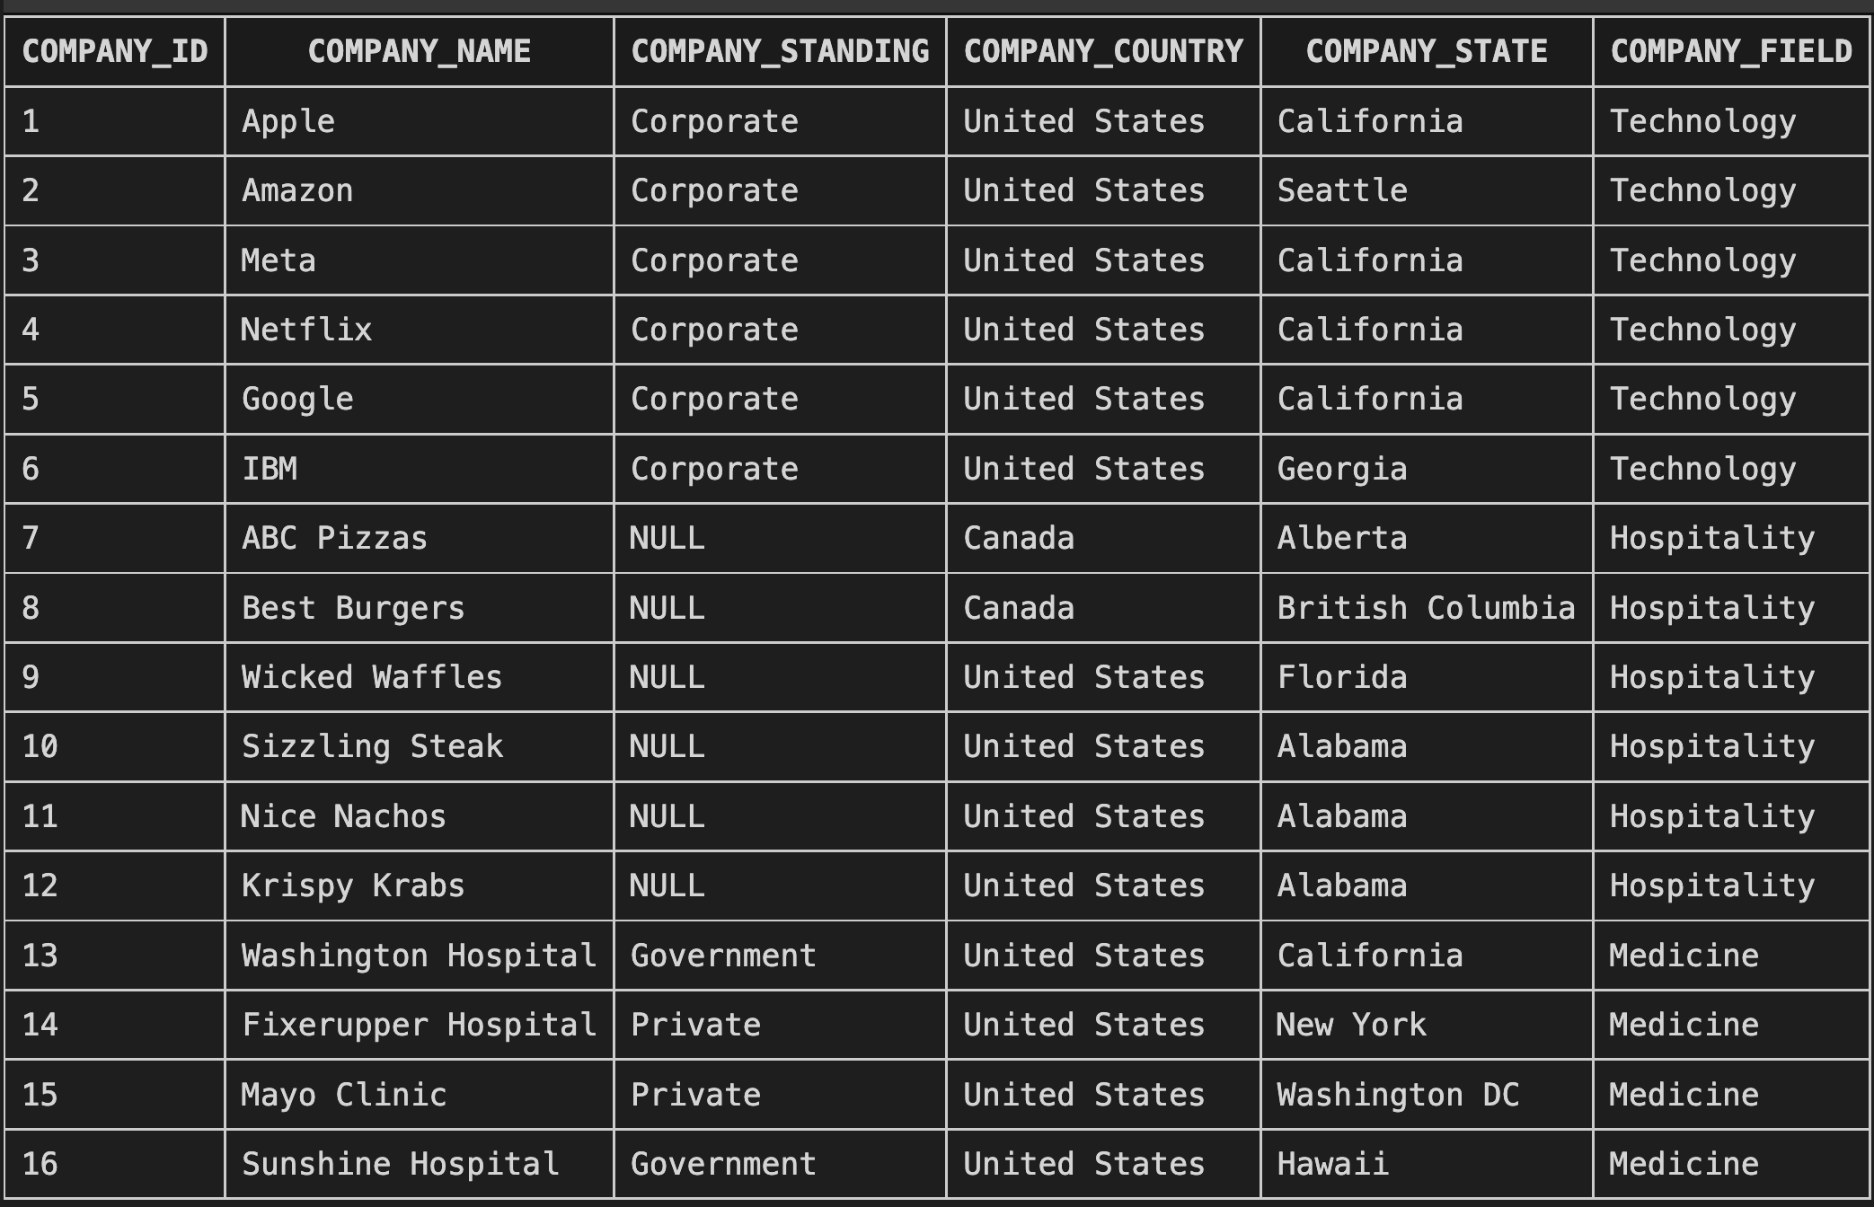
Populated Tables
Field Table
Job Table
Company Table
Notes:
Database populated using various jobs, companies & 142 user inputs

Slide 14
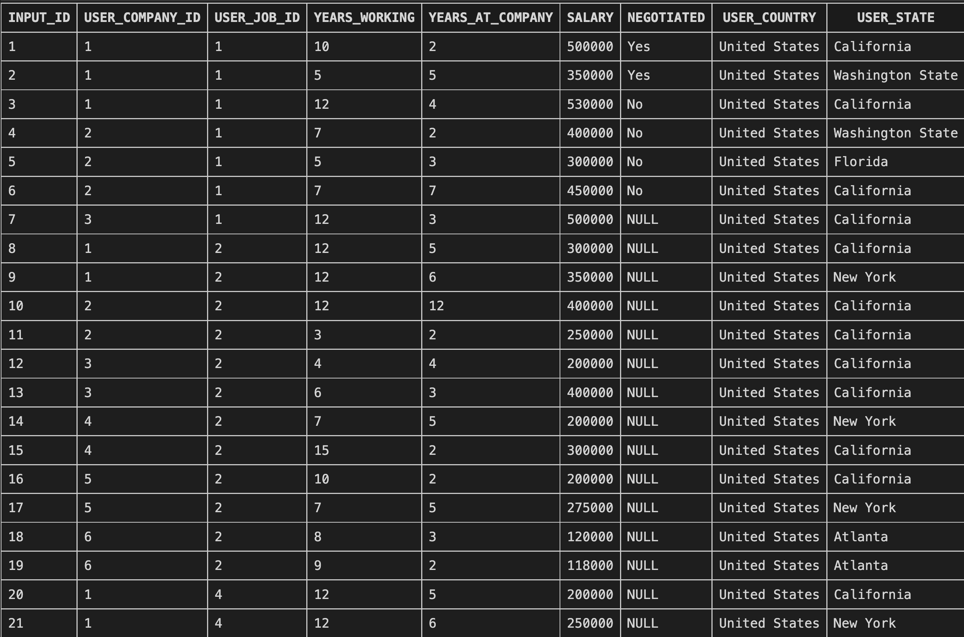
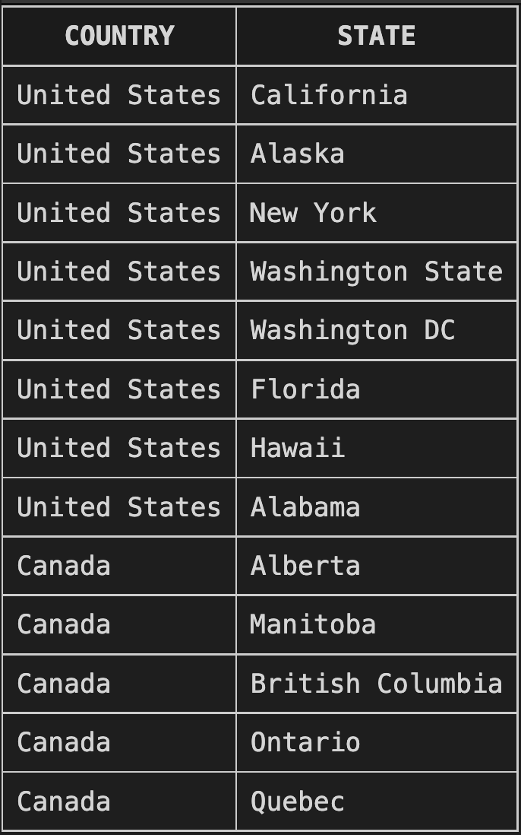
Populated Tables
Location Table
User Input Table
Notes:
Database populated using various jobs, companies & 142 user inputs

Slide 15
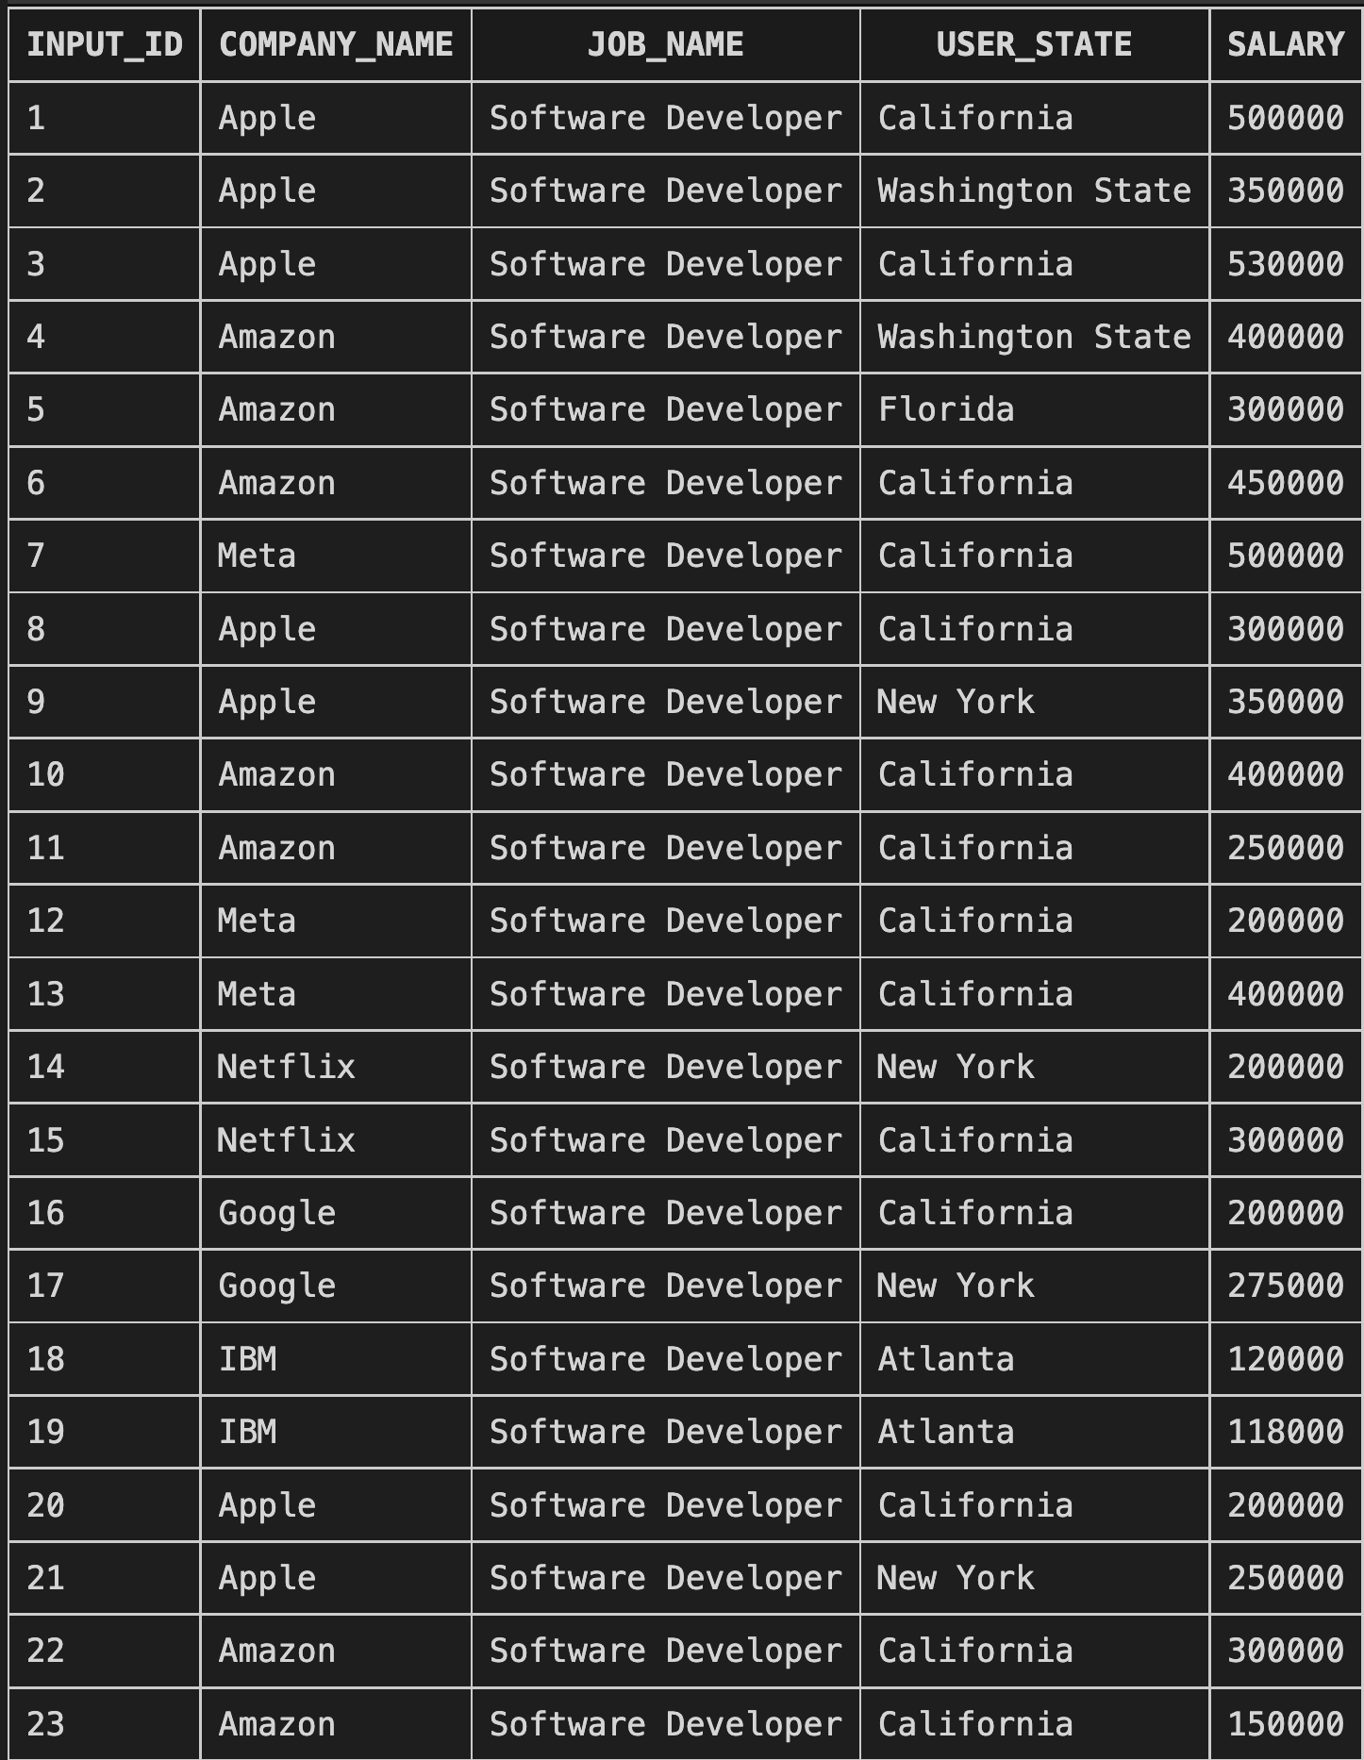
General Query
Notes:
List all user entries – show company name, job name and state

Slide 16
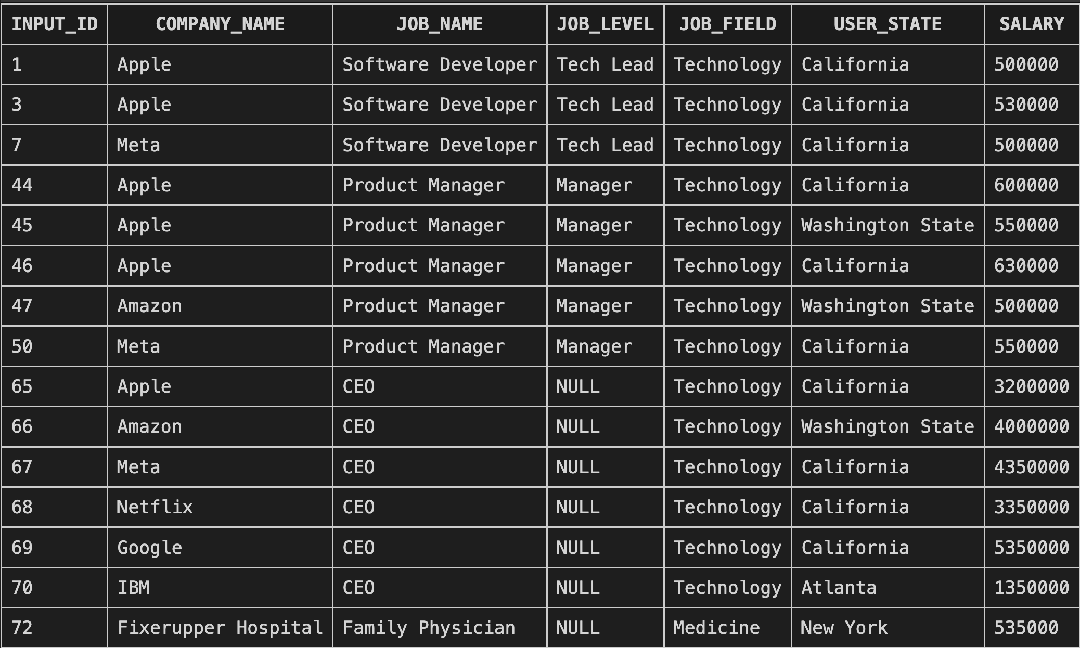
Query Test
Entries with salary >= $500,000
Notes:
Allows queries of specific characteristics ex. we want to see people making salary over 500k

Slide 17
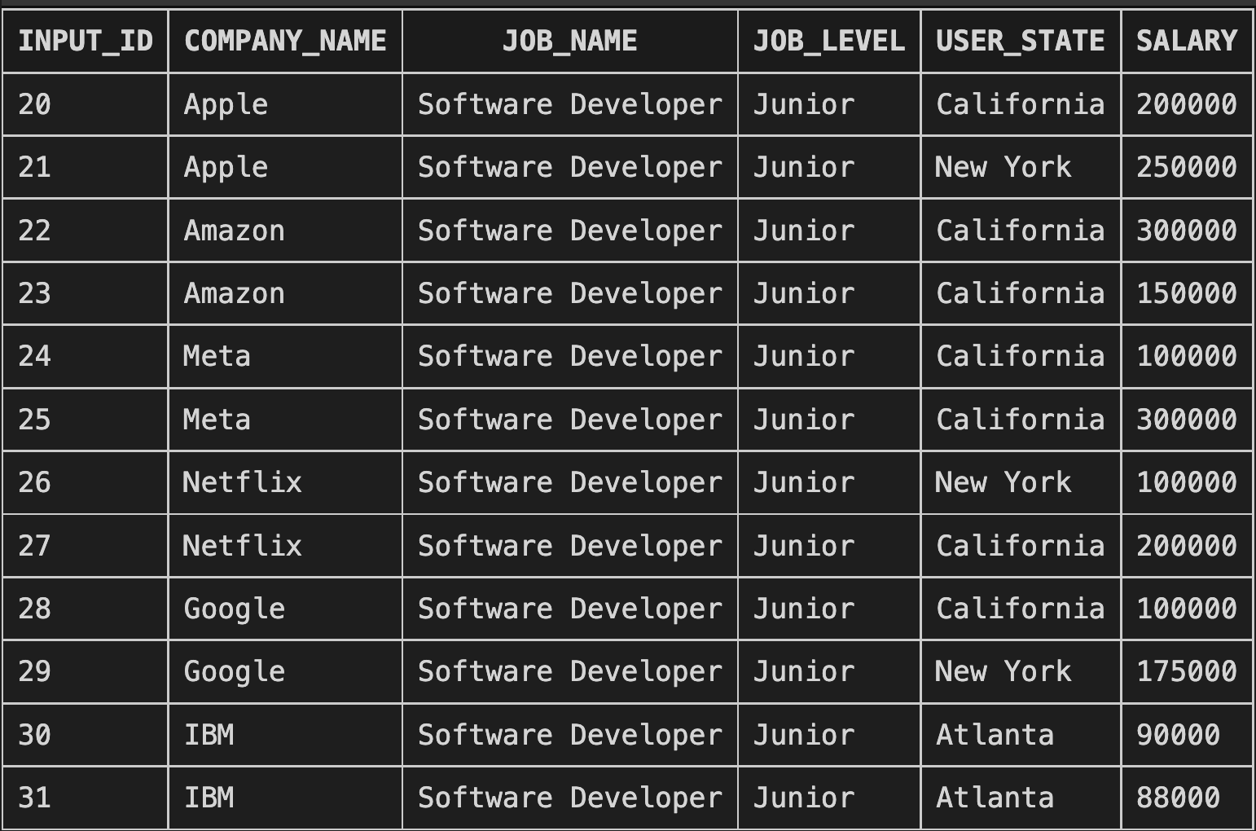
Example Usage
Junior SWE Entries
Notes:
Can analyze variation caused by
Location
Company
Can be leverage for your next negotiation!

Slide 18
DEPLOYMENT

Slide 19
DEMO

Slide 20

Questions?
Find deployed prototype at:

